Slide 1
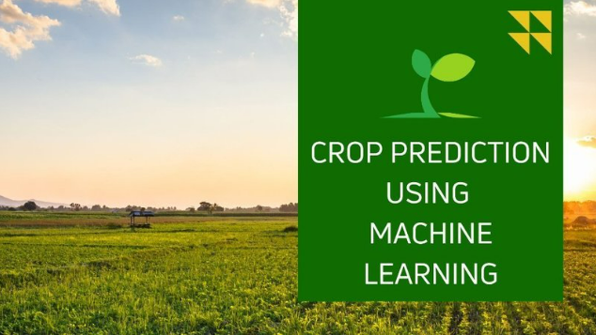
Predicting Crop Production Based on Agricultural Data using Machine Learning

Slide 2
Problem Statement
Agriculture is a key contributor to the economy, and accurately predicting crop production is essential for improving planning and decision-making. This project aims to develop a regression model that forecasts crop production (in tons) based on agricultural factors such as area harvested (in hectares), yield (in kg/ha), and the year, for various crops grown in a specific region.

Slide 3
Project Overview
This regression-focused machine learning project forecasts crop production for different crops across regions and years. It supports data-driven decisions in agricultural planning and supply chain optimization.
Domain : Agriculture
Goal : Predict total crop production
Input Features: Area harvested(hectares), Yield(kg/ha), Year
Output : Crop production (in tons)
By analyzing historical data for various crops in a specific region, the model supports better planning and decision-making in agriculture.

Slide 4
Objectives
Analyze agricultural datasets
Identify key features affecting crop yield
Build and test predictive models
Support strategic planning with actionable insights

Slide 5
Dataset Overview
•📁 Source: FAOSTAT data (Excel format).
•🧩 Fields: Country, Year, Crop, Element, Value.
•📆 Time span: Multiple years (e.g., 2000–2020).
•🔢 Records: 50,000+ entries across crops and regions.

Slide 6
Approaches
1. Data Cleaning and Preprocessing
2. Exploratory Data Analysis (EDA)
Analyze Crop Distribution
Temporal Analysis
Environmental Relationships
Input-Output Relationships
Comparative Analysis
Productivity Analysis
Outliers and Anomalies
3. Task - Predicting Production (Production, measured in tons)

Slide 7
Data Cleaning & Preprocessing
•🧹 Removed duplicates and handled missing values.
•🔠 Encoded categorical features (Crop, Region).
•🔢 Converted 'Year' and 'Value' to numeric types.
•⚙️ Created new features like Yield Efficiency.

Slide 8
Exploratory Data Analysis
•📈 Crop trends over years using line plots.
•🌍 Region-wise and crop-wise summaries.
•🔍 Identified top crops and producers.
•📊 Correlation: Area harvested ↔️ Production.

Slide 9
Model Building
•🔍 Models: Linear Regression, Ridge, Random Forest.
•🧠 Input Feature: Year; Target: Production.
•📊 Evaluated using R², MAE, and RMSE.
•💡 Used Random Forest for best performance.

Slide 10
Prediction Results
•📍 Predicts future crop production for selected year.
•📈 Visualized with trend lines + red forecast marker.
•✅ Exportable CSV with prediction notes.
📊 Model performance

Slide 11
Actionable Insights
•📍 Yield Efficiency & Production Efficiency metrics.
•🌾 Identify best crops for land allocation.
•💧 Maximize water/resource use efficiency.
•📤 Download summary CSV for offline analysis.

Slide 12
Conclusion
•📌 Data science improves crop forecasting accuracy.
•✅ Enables smarter decisions for farmers & planners.
•📈 Model predictions align with historical trends.
•🚀 Expandable with weather, soil & satellite data.

